Slide 1
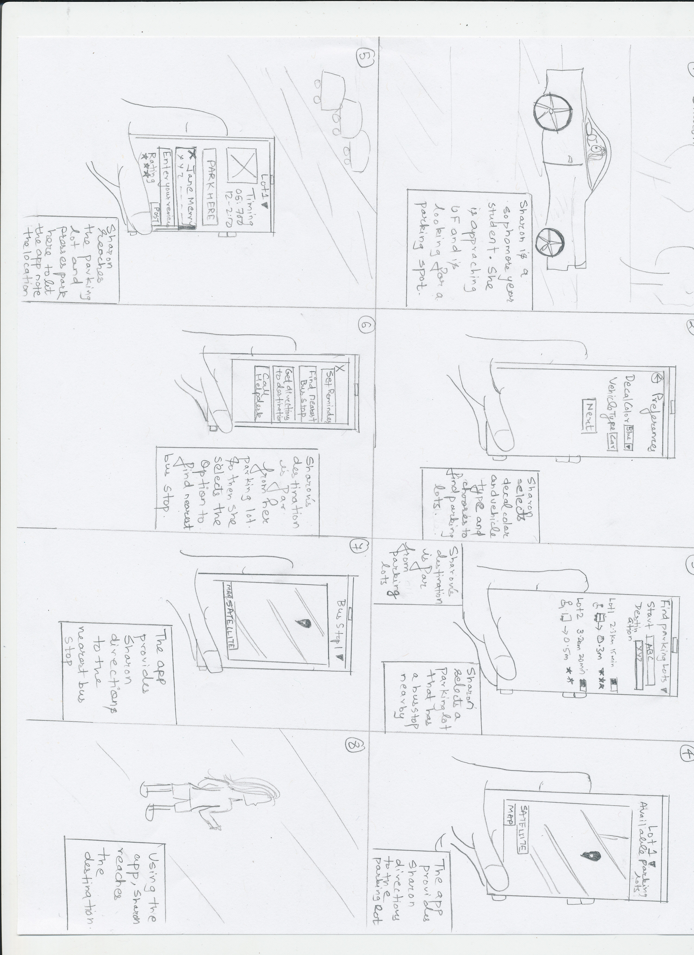
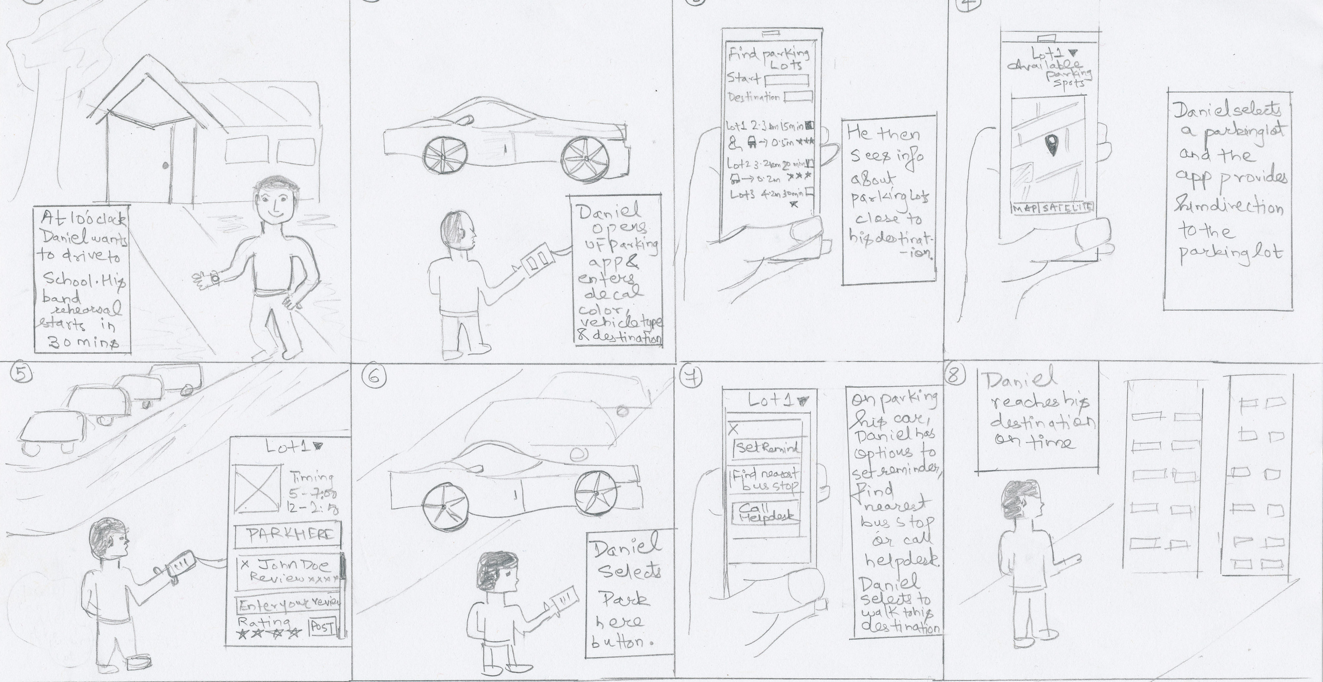
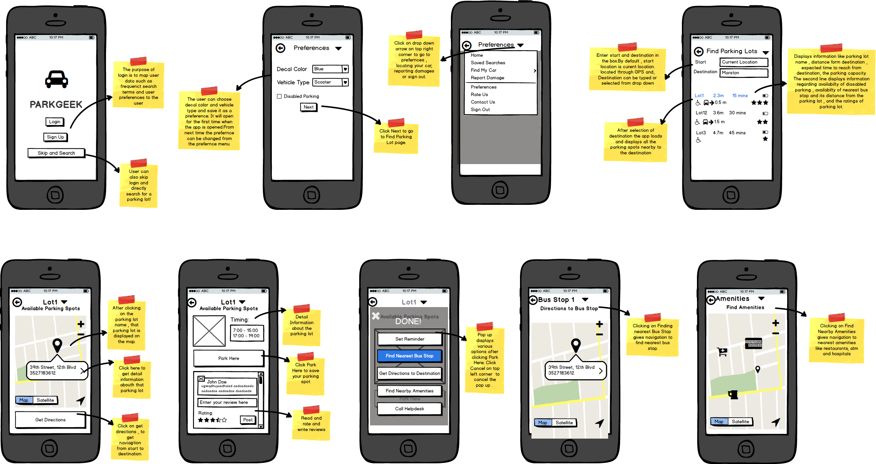
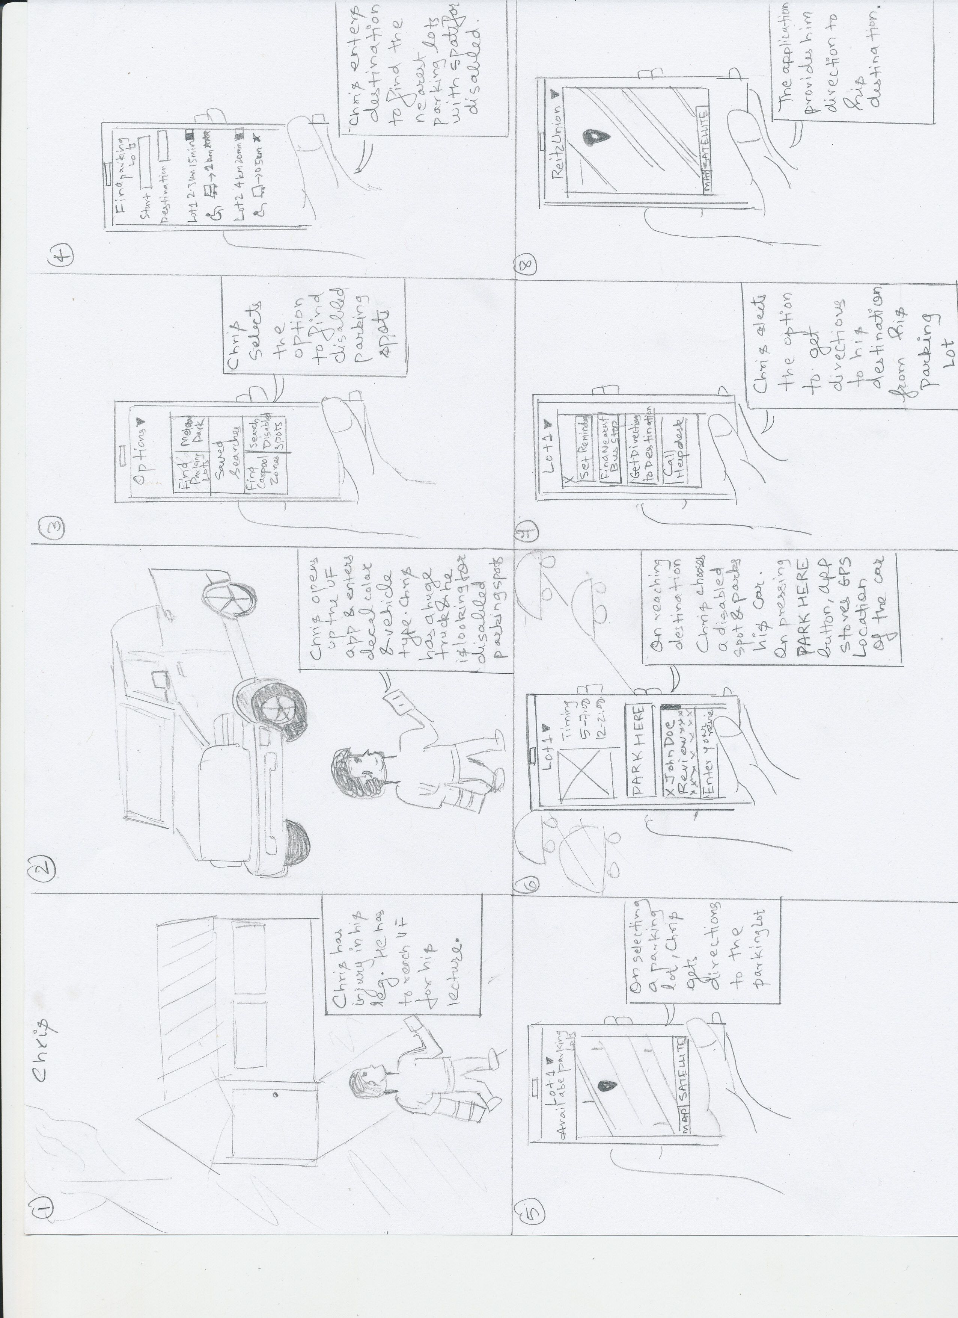
User Needs:
User Personas:
Story Board :
1) Find parking lots accessible to a particular decal color.
2) Report any damages to a car.
3) Search for disabled parking spots in parking lots.
4) Display if any bus stop is near to the parking spot.
5) Navigation instructions from user’s current location to parking lot and from parking lot to destination.
6) Navigation instructions from parking lot to nearest bus stop.
Daniel :
Daniel is head of informatics Society, also being a part of college band. He frequently stays in campus till late nights, always has some events lined up on weekends. Daniel is normally late for school. So he needs to find a parking lot which is not only closer to his destination and but also accessible for his decal.
Sharon:
Sharon is a sophomore studying chemical engineering. She owns a Toyota Corolla. She installs all the latest trending apps and knows how to use them perfectly well. Sharon’s thermodynamics class is quite far from nearest parking lot. So she parks her car and then catches a bus which stops near her chemistry building.
Chris:
Chris loves sports. He is part of UF basketball team. He is not a tech savvy guy. He recently suffered a knee injury and his left leg is in crutches. He owns a Toyota pickup truck. Due to his injury he temporarily parks his car in disabled parking spots close to his destination.
Final Design
Abhishek Banthia Pratik Walawalkar
Chinamaya Kelkar Zehao Chen

